Slide 1
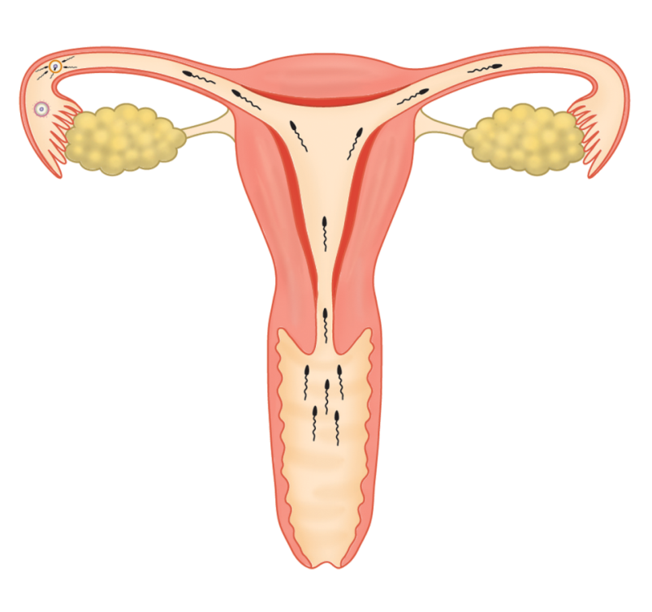
How are sperms transferred into the female body?
ovum
by
sexual intercourse (性交) /
copulation (交配)
sperms

Slide 2
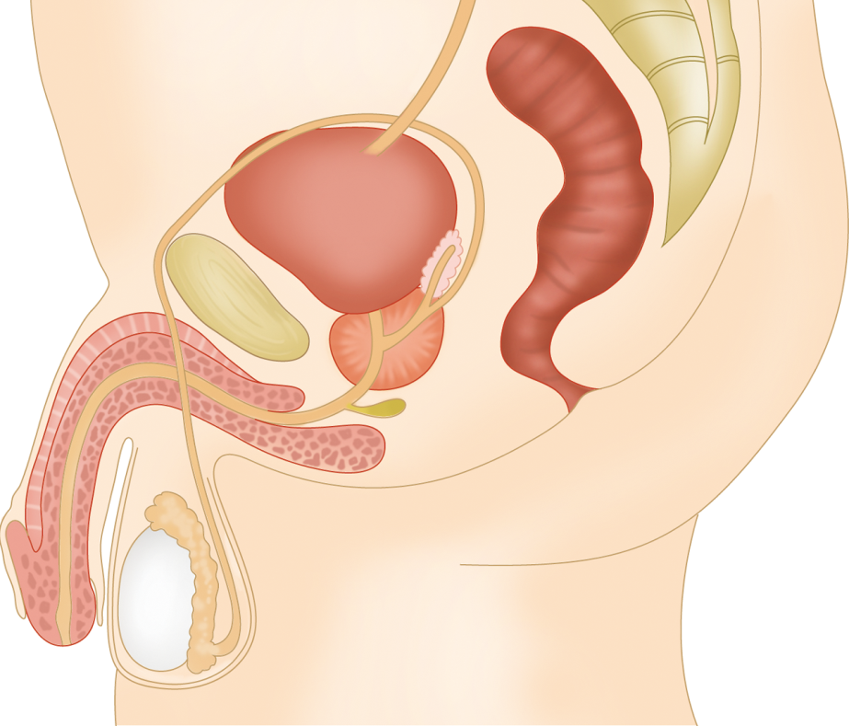
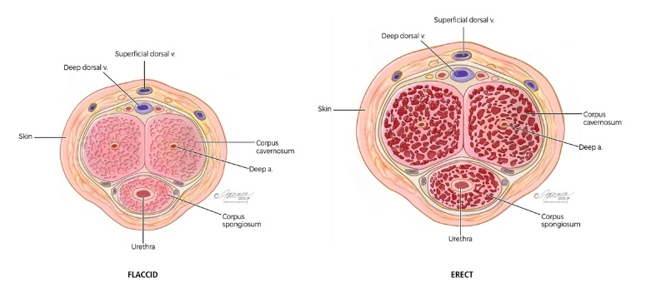
Sexual intercourse
a male is sexually stimulated
the erectile tissues inside the penis are filled with blood
penis becomes hard and rigid
erectile tissues

Slide 3
Sexual intercourse
the penis can be inserted into the vagina of a female for sexual intercourse
  4. ejaculation (射精): muscular contractions of the epididymis, sperm ducts and urethra force semen out of the penis

Slide 4
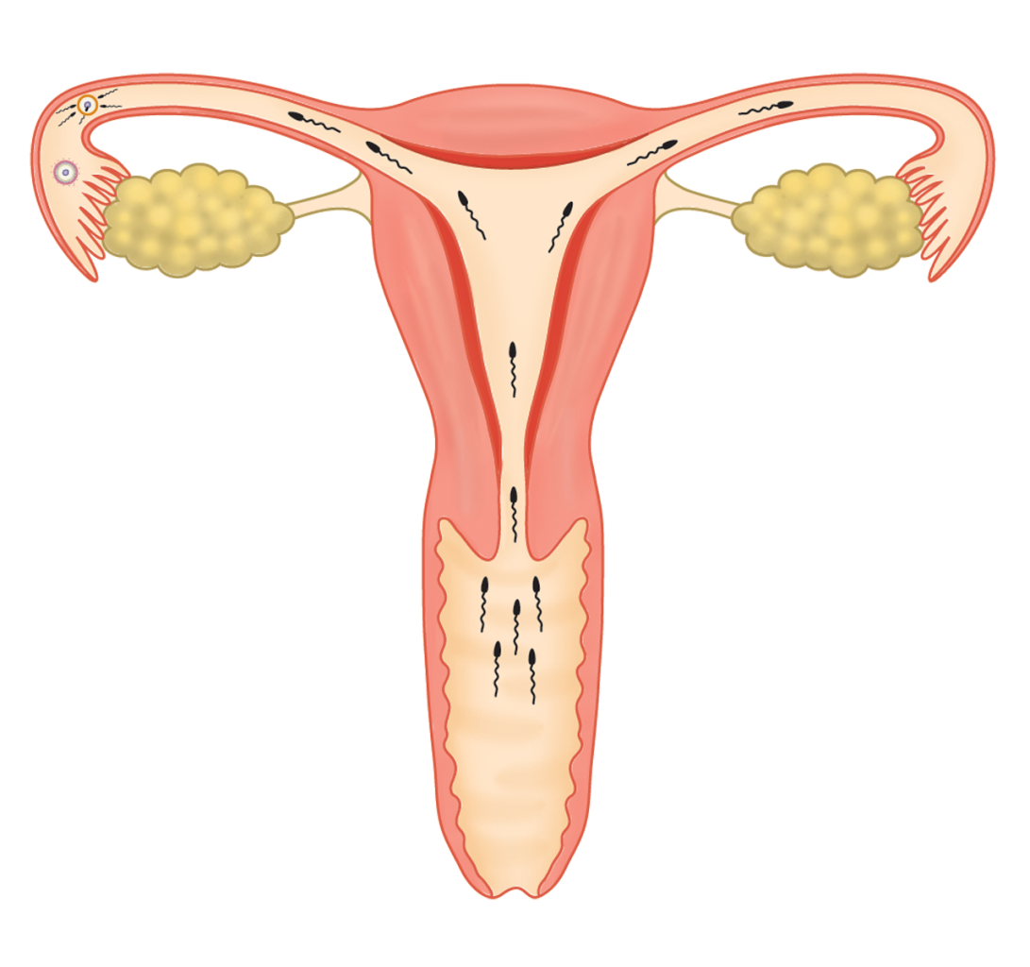
How do sperms reach an ovum?
❶ sperms are ejaculated at the top of the vagina

Slide 5
How do sperms reach an ovum?
❷ sperms swim through the cervix into the uterus
cervix

Slide 6
How do sperms reach an ovum?
oviduct
❸ fertilization occurs in the oviduct

Slide 7
Do all sperms reach the oviducts?
No, because some sperms may be…
trapped by mucus in the vagina
killed by the acidic secretion of the vagina
defective and immotile

Slide 8
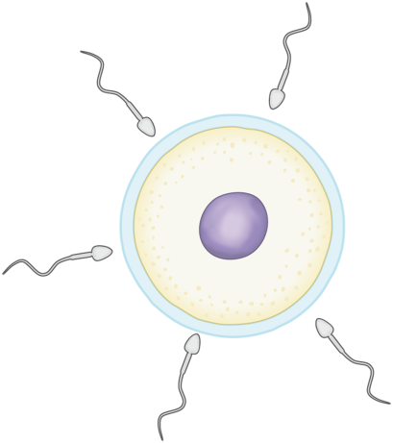
How does fertilization (受精) occur?
the acrosomes of sperms release enzymes to break down the jelly coat of the ovum
jelly coat of ovum
sperm
nucleus of ovum

Slide 9
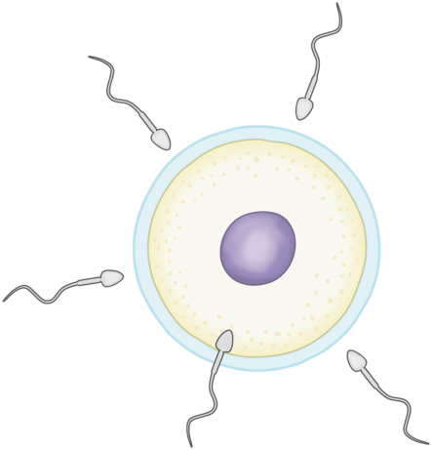
How does fertilization (受精) occur?
one of the sperms enters the ovum
jelly coat of ovum
sperm
nucleus of ovum
one sperm penetrates the cell membrane of the ovum

Slide 10

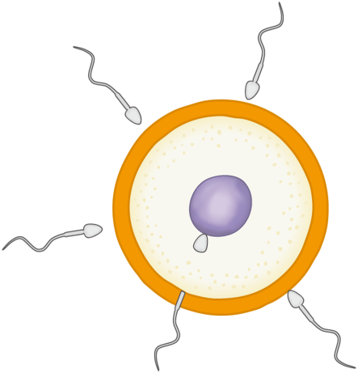
How does fertilization (受精) occur?
the jelly coat changes to prevent other sperms from entering
jelly coat

Slide 11
How does fertilization (受精) occur?
the nucleus of the sperm fuses with the nucleus of the ovum, forming a zygote (合子)
two nuclei fuse
tail remains outside

Slide 12
How does fertilization (受精) occur?
the remaining sperms soon die

Slide 13
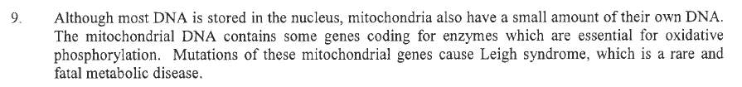
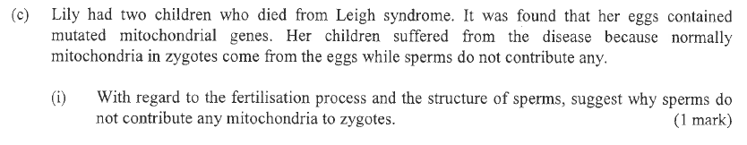
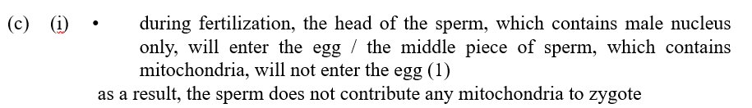
DSE-BIO: 18 1B Q9 (c)(i)

Slide 14
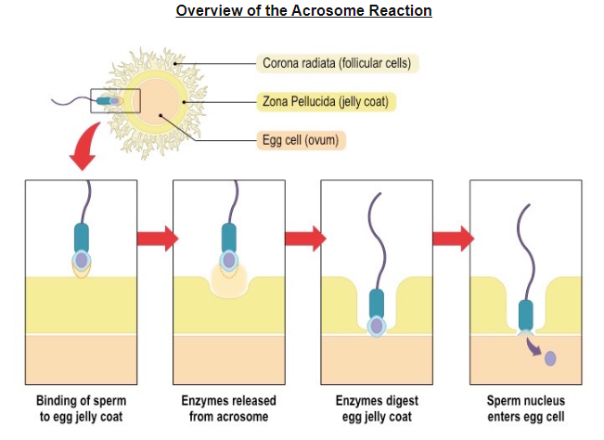

Slide 15
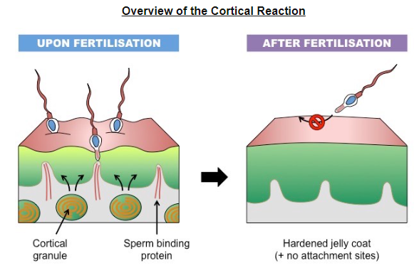
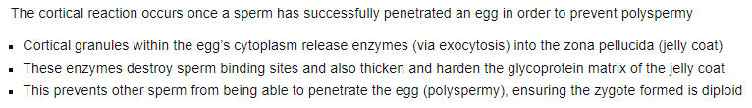
jelly coat
cell membrane of egg

Slide 16
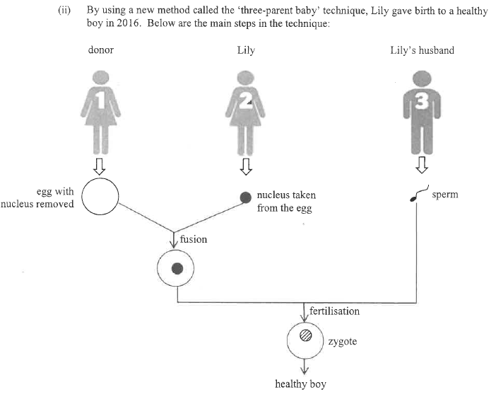
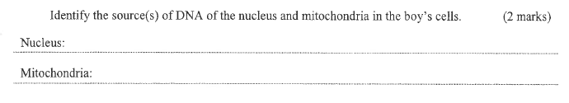

Slide 17
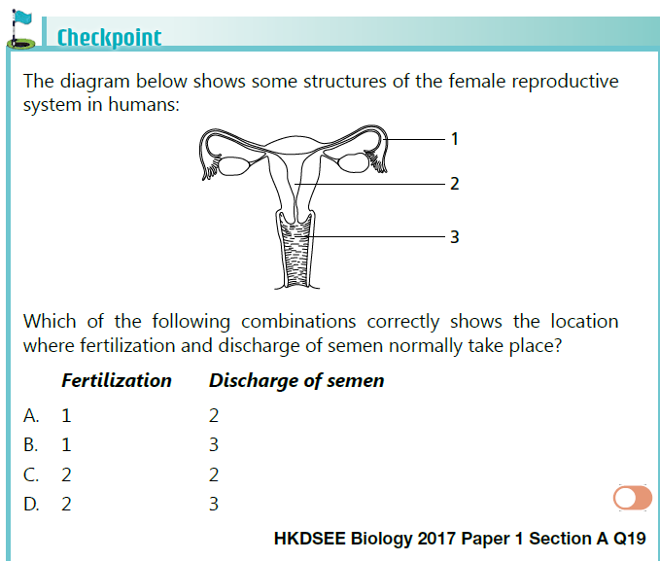

HKDSEE Biology 2017 Paper 1 Section A Q19
(Refer to p.14-16)
B

